Slide 1

and Socket.IO
By niels robin aagaard
(@nielsrobin)

Slide 2
Agenda
Goal
@nielsrobin is …
Why socket.io?
What are websockets?
Setup
Basics
Examples
Chat
Game
Outside examples
Questions

Slide 3
Niels Robin Aagaard
@nielsrobin
https://github.com/nielsrobin
Head of IT
Not a professional software developer
However I’m a coder, hobbyist and father

Slide 4
Why socket.io?
WebSocket
Adobe® Flash® Socket
AJAX long polling
AJAX multipart streaming
Forever Iframe
JSONP Polling

Slide 5

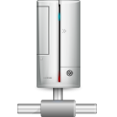

Websockets
When ajax is just too slow
Bi-directional communication
Persistant connections
Client 1
Client 2
Client 4
Client 3

Slide 6
Setup
Install node (www.nodejs.org)
Use npm for the rest
npm install socket.io
npm install mongoose
Or create a package.json
npm install
Notes:
Test this

Slide 7



Putting it together
mongoose
Socket.io
websocket
json
json
Client 1
Socket.io
websocket
json
Client 2
Socket.io
Server

Slide 8

Virtual chat example

Slide 9
Packages used
Primary
mongoose
socket.io
Secondary
underscore
bison

Slide 10
Evolving a game

Slide 11
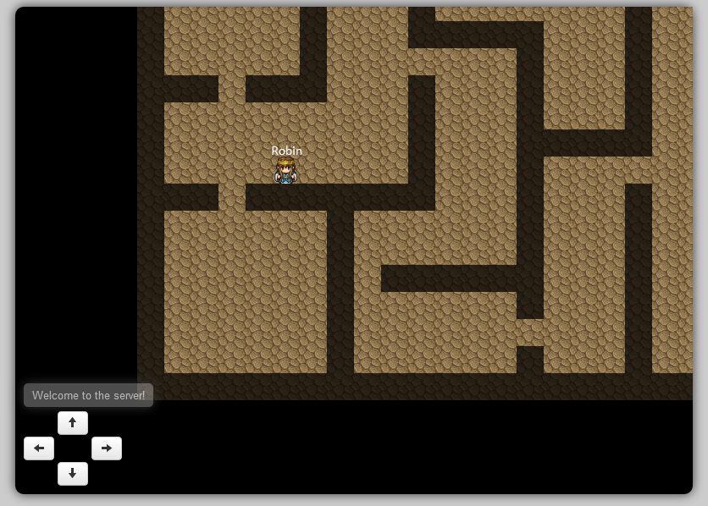

Slide 12
Couple of cool socket.io examples
http://www.webdigi.co.uk/fun/space/
http://hummingbirdstats.com/
http://apps.kaizenweb.dk/games/bows/play.html

Slide 13
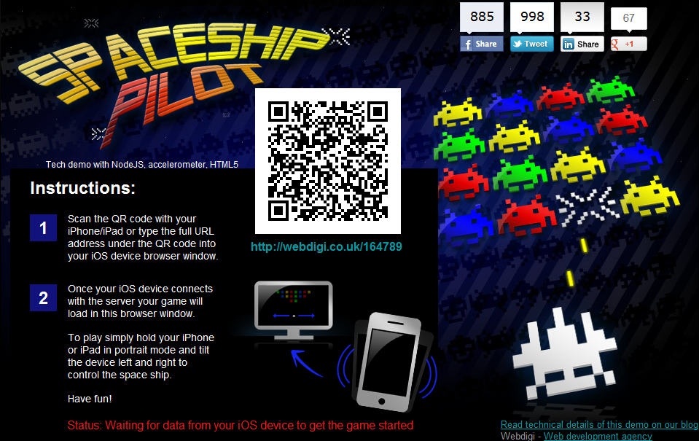

Slide 14
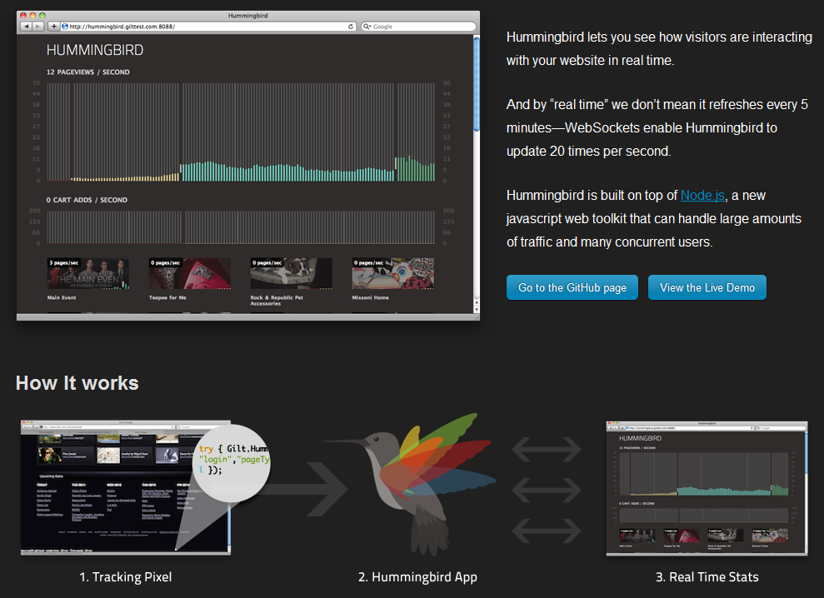

Slide 15
Time for arduino

Slide 16
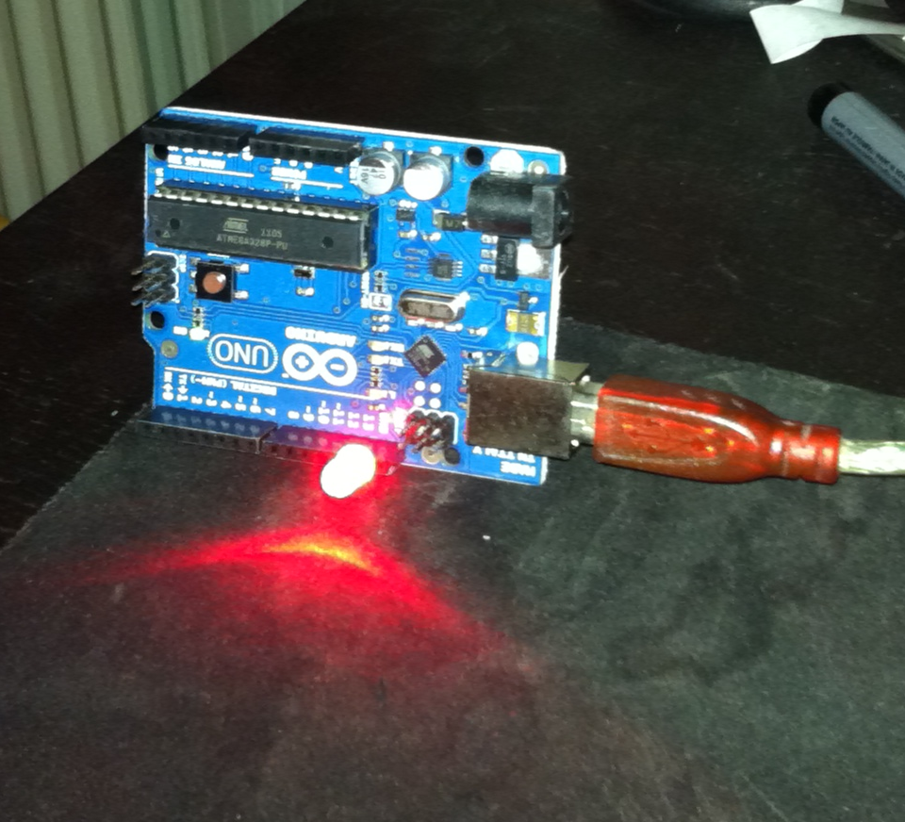

Slide 17
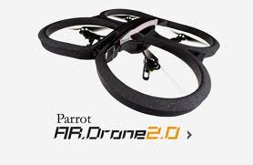
Next step
Engine.io
Performance
Succes first
Websockets and Parrot AR Drone 2.0
nodeJS
Socket.io
node-ar-drone

Slide 18
Questions
Examples are on github: https://github.com/nielsrobin
?

